Slide 1


PROJECT PRESENTATION
ON
STUDENT MARKS PREDICTOR
Guide :
Mr. Ashok Kumar Rai
(Assistant Professor)
Submitted by :
Ayush Ranjan Srivastava
Prachi Sharma
Vandana Tiwari
Varun Kumar Singh
B. Tech. (4th Year)
Department of Computer Science & Engineering
Buddha Institute of Technology,
GIDA, Gorakhpur

Slide 2
CONTENTS
Introduction
Motivation & objective
E-learning and Evaluation through Online Classes
New Problem – Access to Internet
Aim and Problem Statement
Proposed Solution : Machine Learning Model
Why Machine Learning ???
About proposed model
Workflow Of Our Solution
Inside our Model
Student Marks Predictor v1.0

Slide 3
Introduction
Year 2020 was a real tough year for the world. Mankind faced a terrible pandemic, CORONA, caused by a Chinese originated virus COVID-19. This showed us the reality of the so called developed nations , as vaccine took more than a year, to get discovered. This not only affected the world’s economy but also destructed the social life of people.
This pandemic had a huge affect on the education system of entire world, as almost all the schools and colleges around the globe was shut, and classes were called off for almost for half a hear. This not only created a lag in academic calendar of the institutions , which could lead to a disaster for any student as his year could get wasted .
Various methods were used to tackle the problem by various institutions and government. Our main aim of making this project was just to propose another method to take on this problem caused due to pandemic.

Slide 4
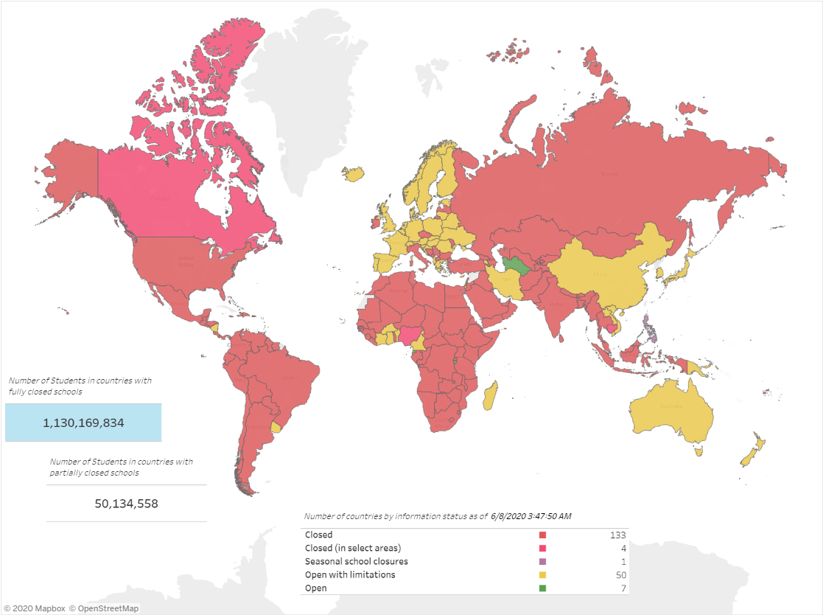
Motivation and Objective
The above map shows that how the COVID-19 pandemic affected entire world. About 90% countries around the world completely locked them down. This caused an immediate break to the academic and school related work. The studies of around 2 billion people were affected harshly. So there was a need for strong and firm solution for the students so that their year won’t go useless.

Slide 5
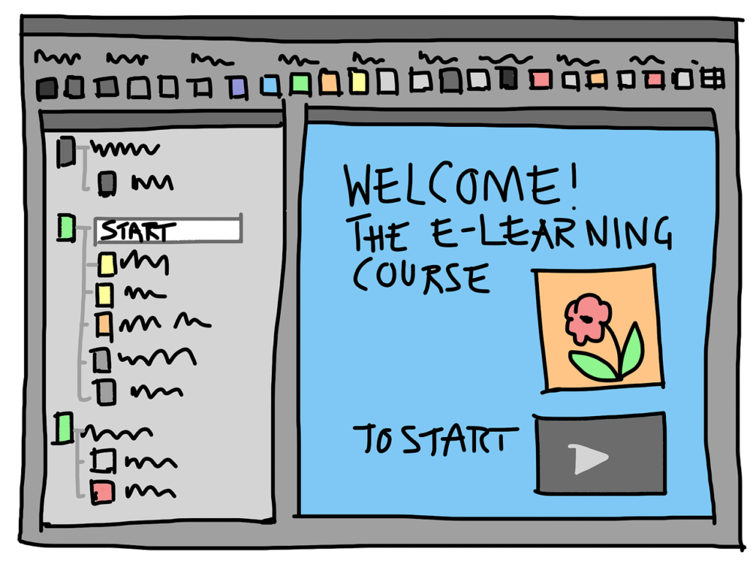
E-learning and Evaluation Through Online Exams
For evaluation of a students score and conducting a fair exam a method was thought, online examination. This was a used solution which was already used in various sectors like in distance learning. So this was the first idea that was made to replace the classroom studies for short span of time.

Slide 6
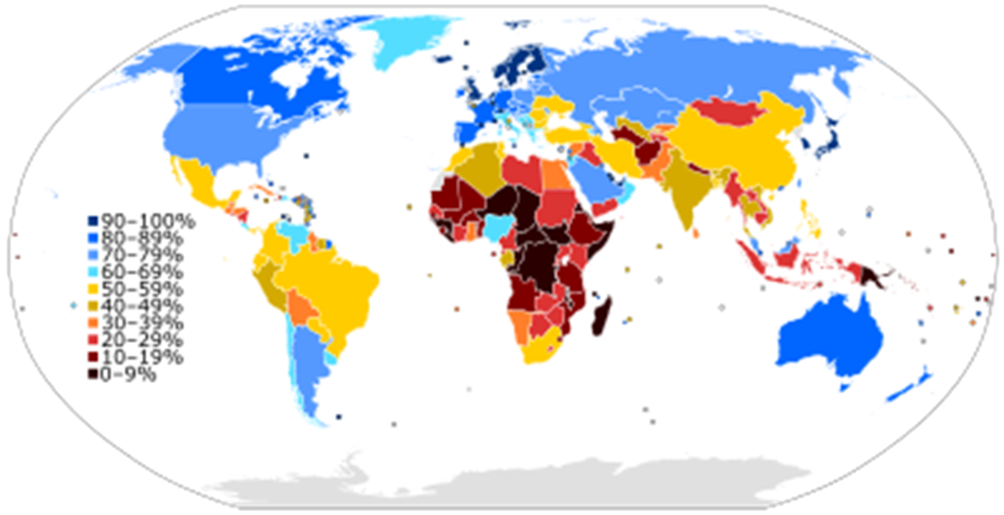
A new problem – Access to Internet
The problem raised in online was the access to internet. If we talk about India, only 35% of total population has access to high speed internet. So everyone didn't get access to study or give exams.

Slide 7
AIM And Problem Statement
To find a genuine method for evaluation of Marks without conducting exams, and should be authentic and accurate.

Slide 8
PROPOSED SOLUTION – A MACHINE LEARNING MODEL
Our solution to this problem is to make a Machine Learning model that was able to predict the total percentage of marks a student with the help of his total hours of class attended/ studied.
To get the justified solution we took the previous performance of the student as sample data.

Slide 9
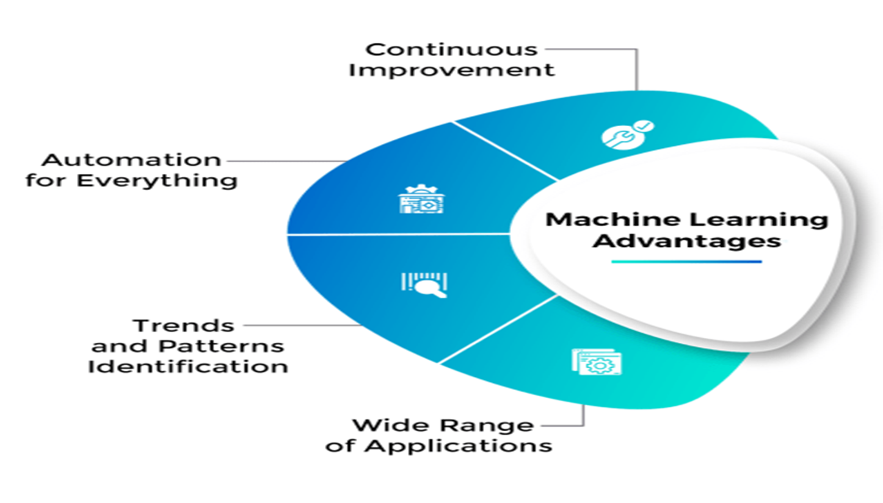
Why Machine Learning ???
Machine Learning is used as it has the capability to predict the output required. It is most reliable and a trending technology of this century.

Slide 10

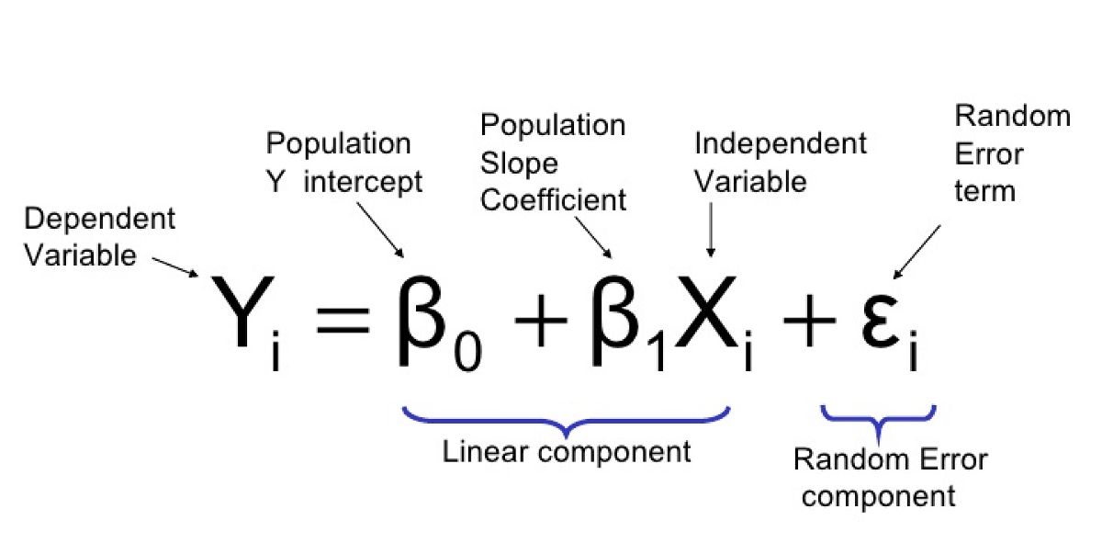
About the proposed Model
Model Uses Linear Regression
Model is implemented on Flask Framework

Slide 11
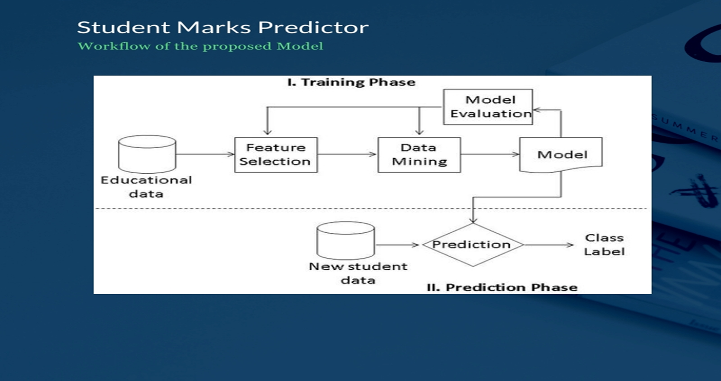
Workflow of our solution

Slide 12
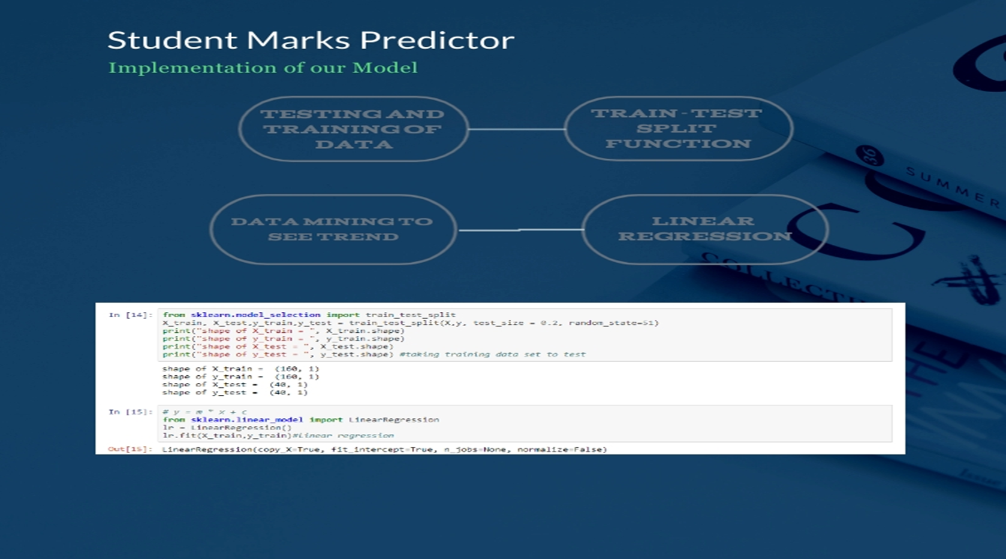
Inside our Model…

Slide 13
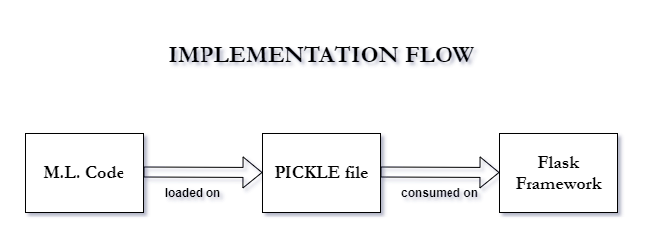
Implementation Flow Of Our Model…

Slide 14
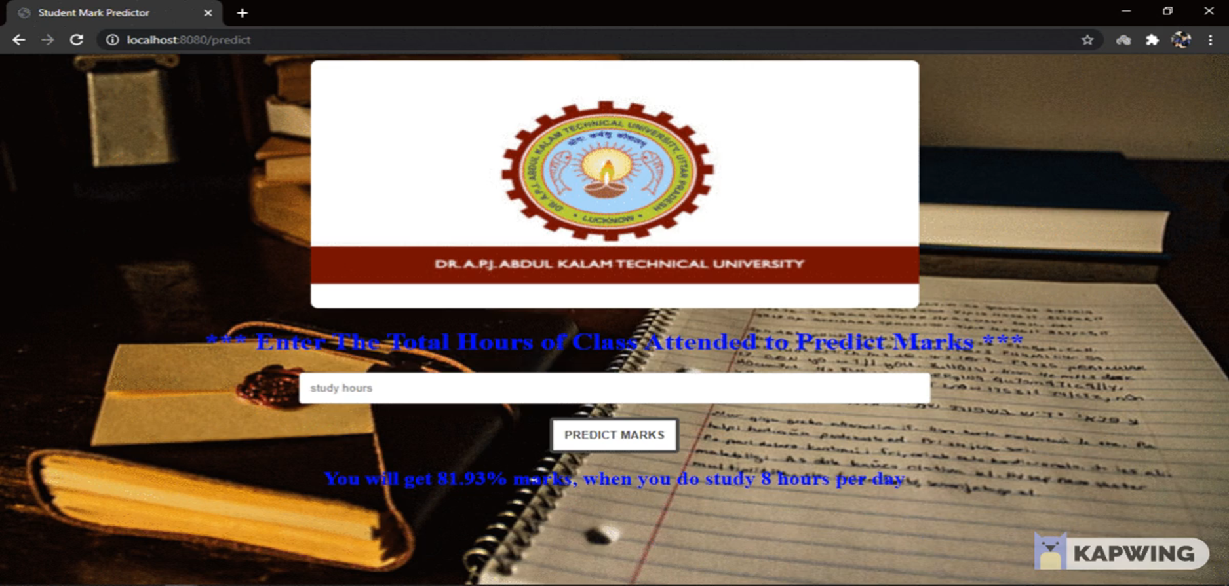
Student Marks Predictor v1.0

Slide 15
CONCLUSION
Predicting student’s performance would boost the results of student’s grades and gives teachers a better approach for teaching the students who are at risk of failure. Regression models, tree based models are created to make the best predictions with high accuracy. The basic idea is to increase the efficiency of the prediction results using various algorithms . Thus by finding the RMSE, we observed that linear model gives optimum results.

Slide 16
Use after Pandemic? Other usage and further improvements…
After pandemic this could be used for predicting students performance in exams by the schools, colleges and coaching institutes so that they can know on which students they need to pay attention to more.
This is actually a Machine Learning model without learning capabilities i.e. though it uses the data and makes a relationship and provide us accurate output, but what if we need to change the input datasets and provide real time input and output of a large number of students. So further, this has to be a real time model in which we can change the training data sets at real time to get more effective data.

Slide 17
Thank You
Any Queries…..?

